Slide 1
iSLA-2025-0038-R00-mmW.pptx
WI: mmW Plenary Meeting 05
iSLA event and 6th meeting information
R
For approval For discussion For information
Date: 2025-Feb-13
Source:
Affiliation | Contact | Email
iSLA | Shen Yan | academic@sparklink.org.cn

Slide 2
iSLA-2025-0038-R00-mmW
Copyright Notification
By no means of any part of this document can be reproduced or used without prior written permission of International SparkLink Alliance. Copyright © 2020-2025 The International SparkLink Short-range Communications Alliance. All Rights Reserved.

Slide 3
iSLA-2025-0038-R00-mmW
Roundtable: SparkLink—Connect the Intelligent World
Highlights
High-profile Guest Speakers
Top officials from CAICT and renowned academicians will present the superiority of SparkLink technology in AI domain.
Giant Enterprises Sharing Experience
Companies like China Mobile, Lenovo, and ZTE, among others, will share their SparkLink applications in "Human-Vehicle-Home-Campus" scenarios.
On-site Experience of SparkLink Technology Advantages
Exhibiting SparkLink products, attendees can personally experience the smoothness of SparkLink products and the latest SparkLink innovations and applications.
Introduction
Agenda Moderator: Luis (Former ETSI Director General)
Theme：SparkLink—Connect the Intelligent World
Organizer：International SparkLink Alliance
Date & Time： March 5, 2025 (Day3) 15:00-18:00
Venue： W Hotel, Plaça Rosa Del Vents 1, Final, Pg. de Joan de Borbó, 08039 Barcelona, Spain
Target Audience：Telecommunication operators + Smart device & Automotive companies + Standardization bodies, approximately 30-50 attendees on-site
Application Method： Apply via CIMS + Targeted Invitations
KM：
SparkLink technology standards are advancing, moving progressively towards international adoption.
SparkLink offers superior experiences in the "Human-Vehicle-Home-Campus" application domains.
The SparkLink industry ecosystem is flourishing, with massive participation from leading enterprises.
Spot | Duration | Topic | Speaker
15:00 - 15:05 | 5 | Opening Address | CAICT
15:05 - 15:25 | 20 | SparkLink: Powering Connections for Devices in Intelligent World | Chair of Academic Committee of iSLA
15:25 - 15:45 | 20 | SparkLink for Home: Upgrading Smart Homes with SparkLink Broadband Routers | China Mobile
15:45 - 16:05 | 20 | SparkLink for Human: Enhancing User Experience through SparkLink Terminals | Lenovo
16:05 - 16:20 | 15 | Tea Break
16:20 - 16:40 | 20 | SparkLink for Home and Campus: Empowering Smart Homes and Campus with SparkLink | ZTE
16:40 - 17:00 | 20 | SparkLink for Vehicle: Tackling Blind Spots in Large Vehicles with SparkLink 360 Surround View | EAGLE DRIVE
17:00 - 17:20 | 20 | SparkLink for Vehicle: Unlocking Smart Journeys by SparkLink Digital Car Keys | AITO
17:20 - 17:40 | 20 | New Trends in Short Range Technology: A Call for SparkLink Technology
17:40 - 18:00 | 20 | The Established Standard System and Ecosystem of SparkLink | Vice President of iSLA

Slide 4
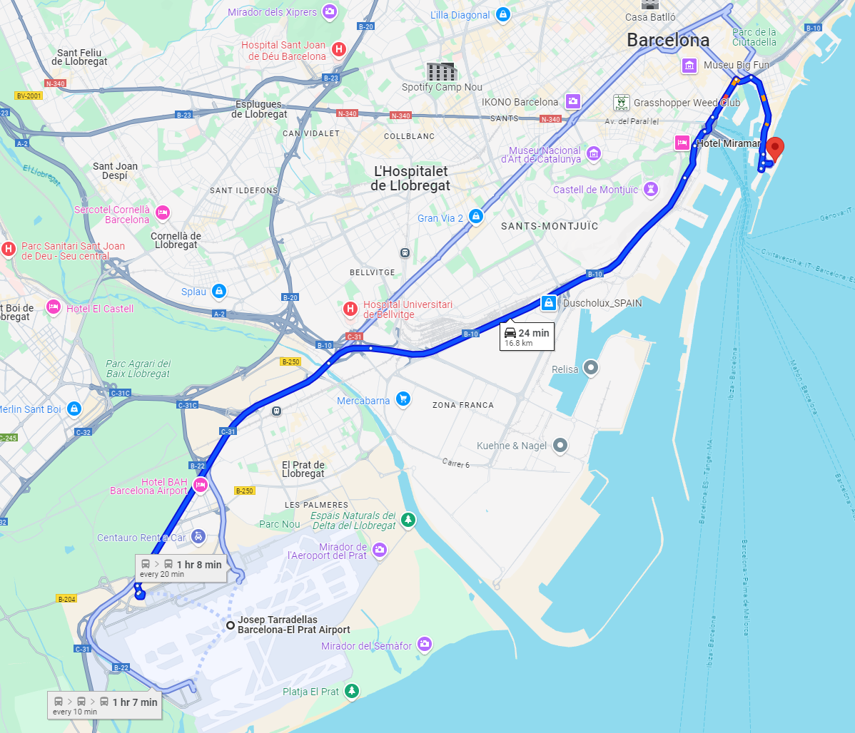
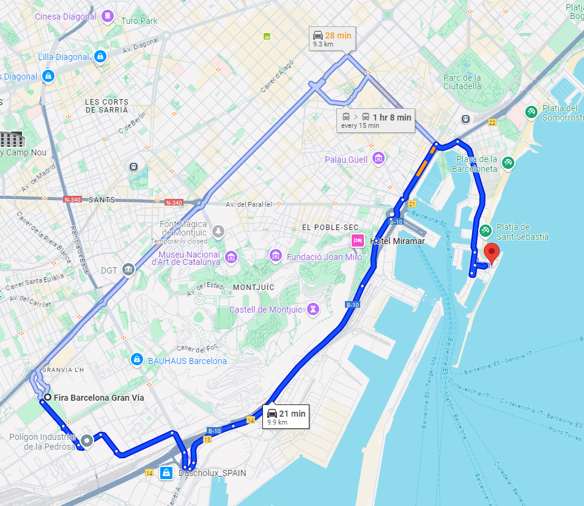
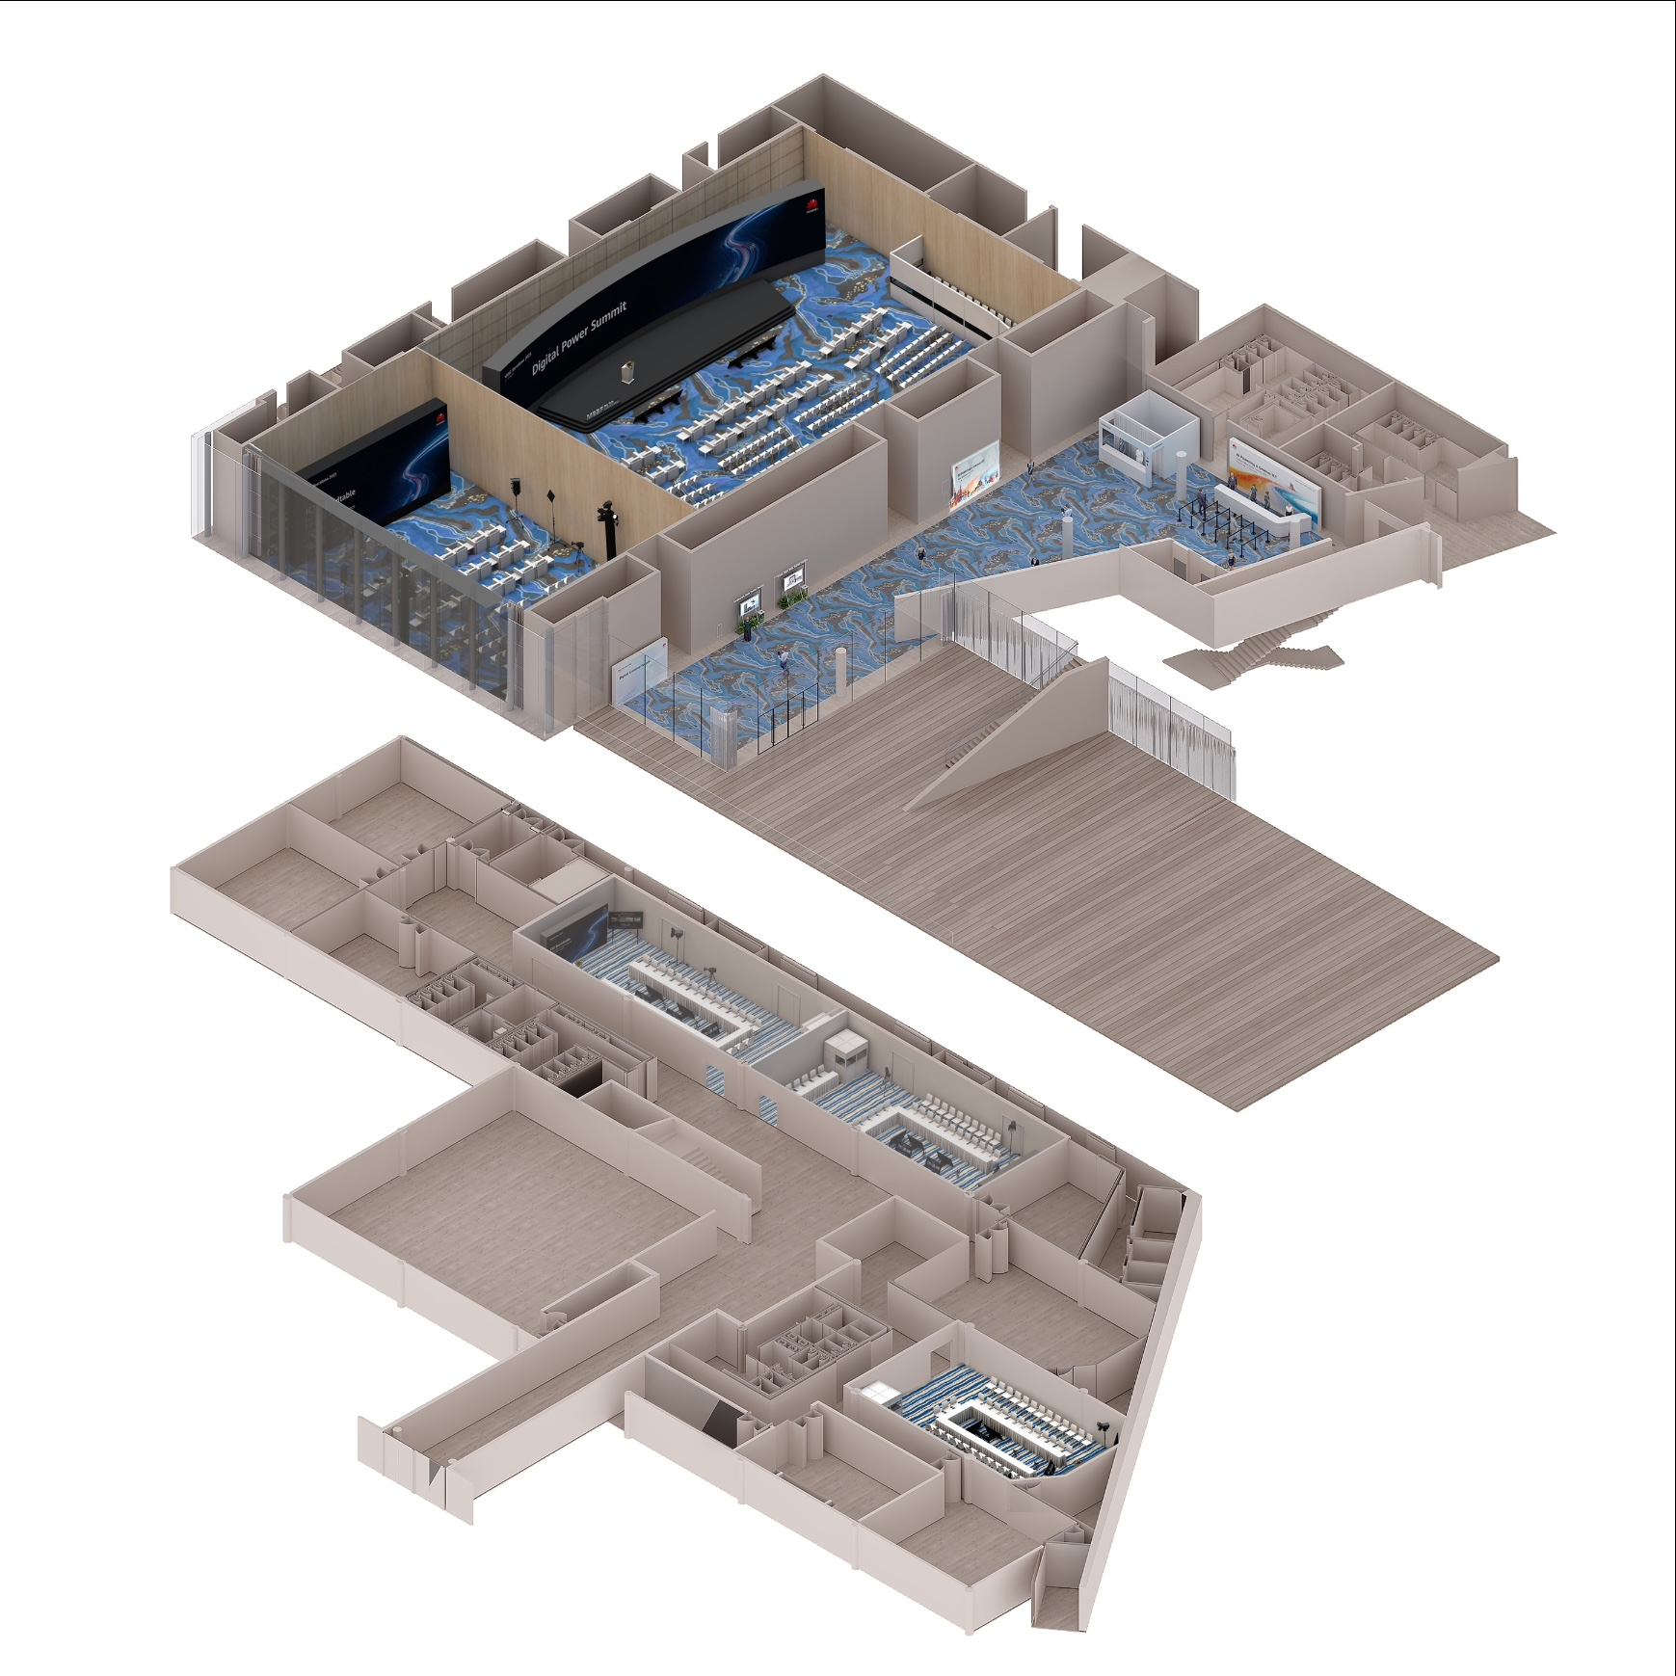
iSLA-2025-0038-R00-mmW
W Hotel Barcelona
Address: Plaça Rosa Del Vents 1, Final, Pg. de Joan de Borbó, 08039 Barcelona, Spain
W Hotel
W Hotel
Fira Gran Via
MWC 2025 halls
Airport
F1
24-minute drive from Airport to W Hotel
21-minute drive from MWC 2025 halls to W Hotel
Stairs
Entrance
B1
Studio 3+4
Registration Area
& Exhibition Zone
Welcome Drink
& Tea Break Area
B1, Studio 3+4

Slide 5
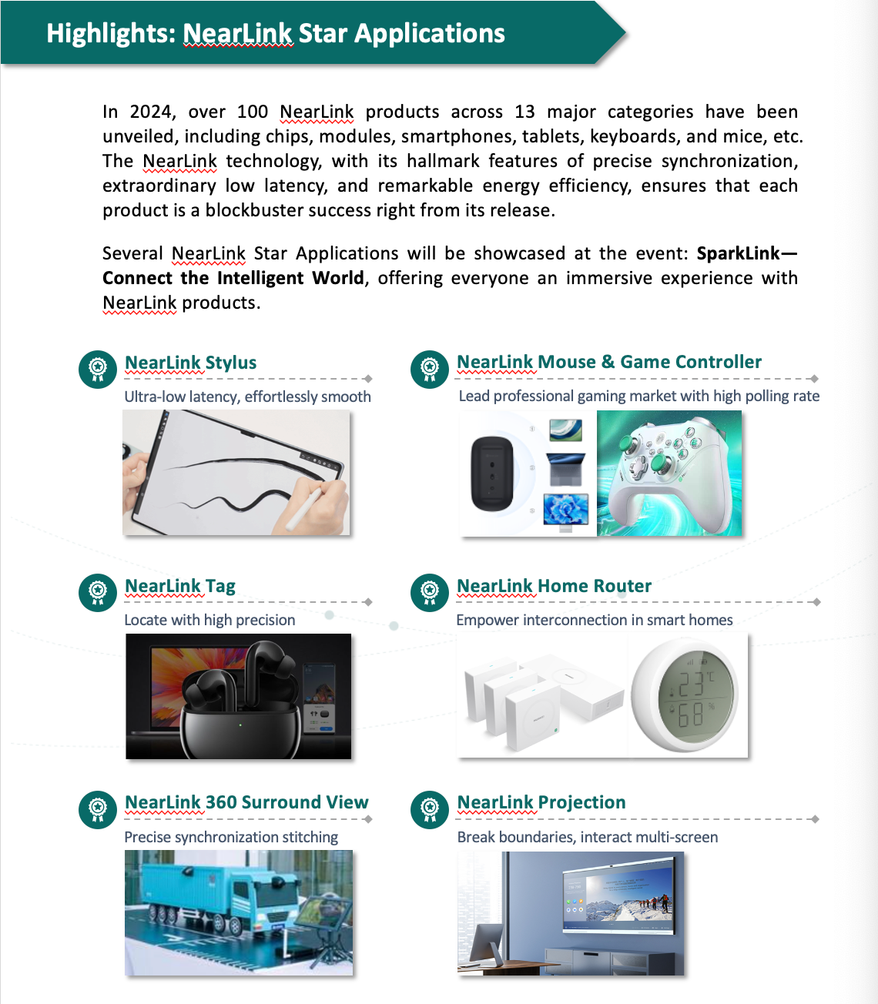
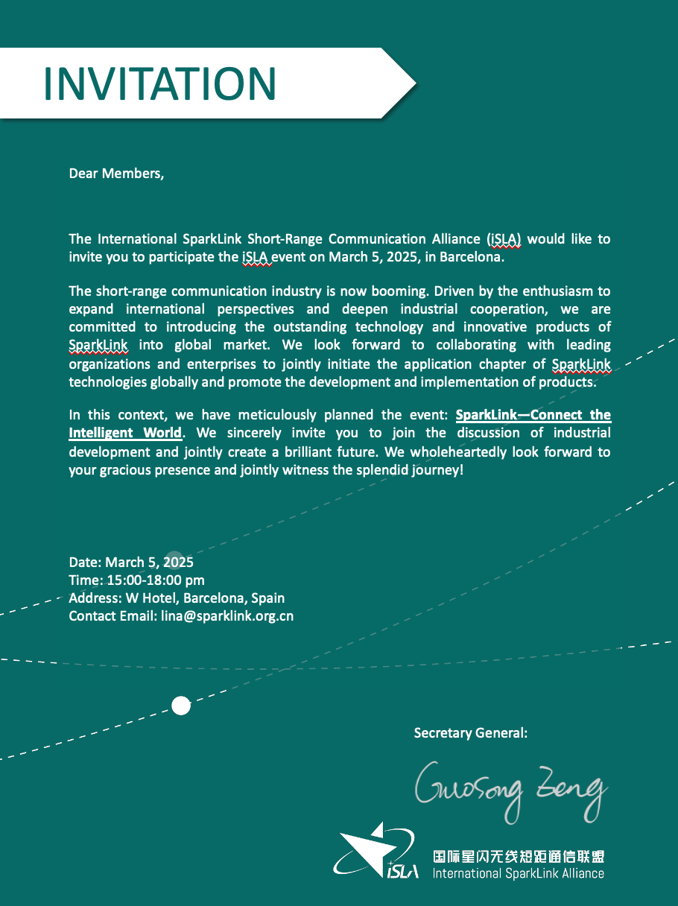
iSLA-2025-0038-R00-mmW

Slide 6
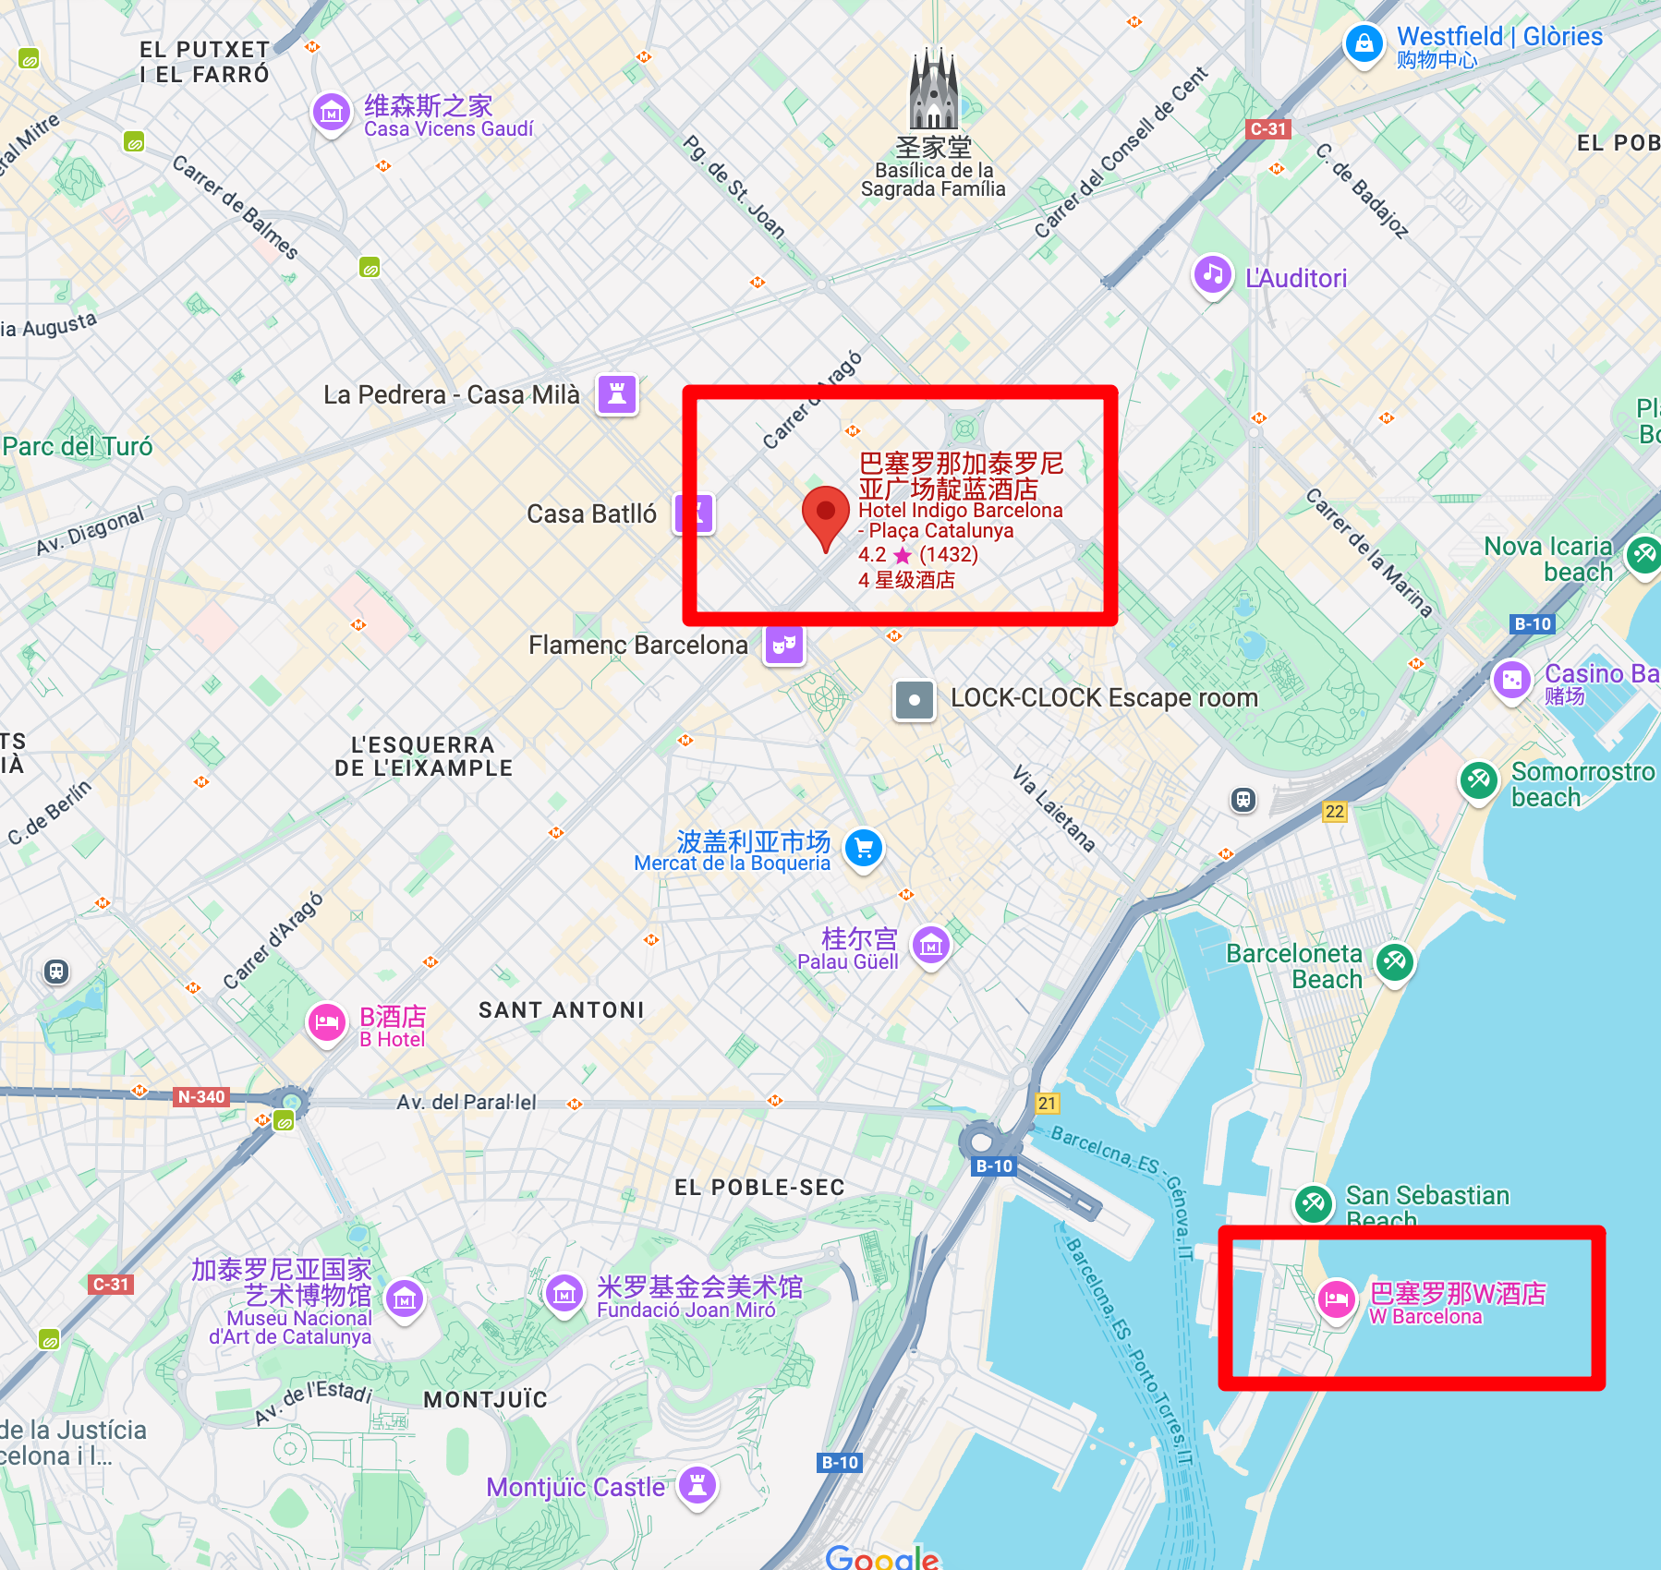
iSLA-2025-0038-R00-mmW
6th mmW Meeting, Barcelona
Date: Mar. 6 (Full day) ~ Mar. 7 (Half day)
Place: Hotel Indigo Barcelona – Plaza Catalunya
Address: Gran Via de les Corts Catalanes, 629, L'Eixample, 08010 Barcelona, Spain
03.06~03.07
03.05 Afternoon

Slide 7
iSLA-2025-0038-R00-mmW
At a glance
Invite letter will be sent soon. Welcome.
Need to register (Free of charge) in advance.
1 or 2 presentations opportunities
DDL
Presentation: before 2.19
Register: before 2.28
02.06~02.07
02.05 Afternoon

Slide 8
iSLA-2025-0038-R00-mmW
Q&A

